Slide 1
Food and Water Quality Monitoring
Detection of Escherichia coli in lettuce samples
Kenneth Geshell, David J. You, Jeong-Yeol Yoon
Biosensors Laboratory
Agricultural & Biosystems Engineering
University of Arizona

Slide 2
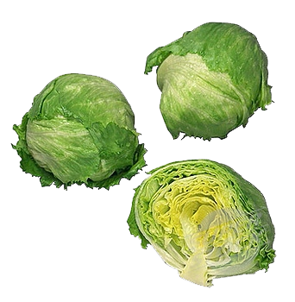


Introduction
Escherichia coli is a leading cause of food-borne disease.
Outbreaks of Escherichia coli O157:H7 is prevalent
  2006: E. coli found in Dole bagged fresh spinach; 200 illnesses and 3 deaths.
  2006: E. coli found in Taco Bell lettuce; 53 hospitalized.
  2008: E. coli outbreak in Michigan in iceberg lettuce from California; 36 illnesses

Slide 3
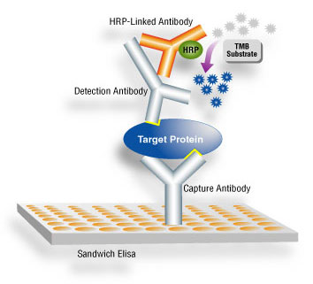
Current Methods
Conventional culturing and colony counting
  Requires days for culturing and skilled personel.
Enzyme-linked immunosorbent assay (ELISA)
  Requires multiple steps of reagent addition and rinsing. Too complex to use in the field.
Polymerase chain reaction (PCR)
  Requires pre-designed primers.

Slide 4
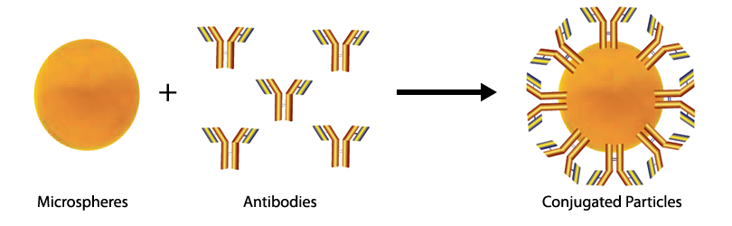
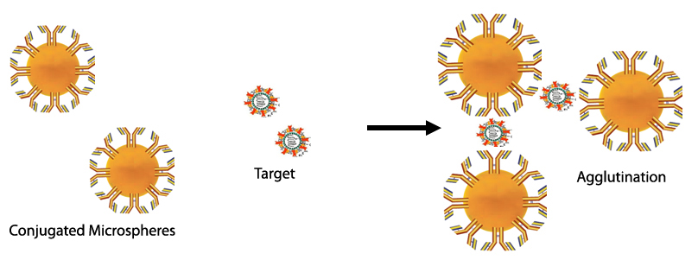
Background
Sensing Element: Immunoaffinity
  Sample fluid is mixed with particle solution, and target cells are captured by antibody-antigen binding
  This causes particles to adhere together in clumps

Slide 5
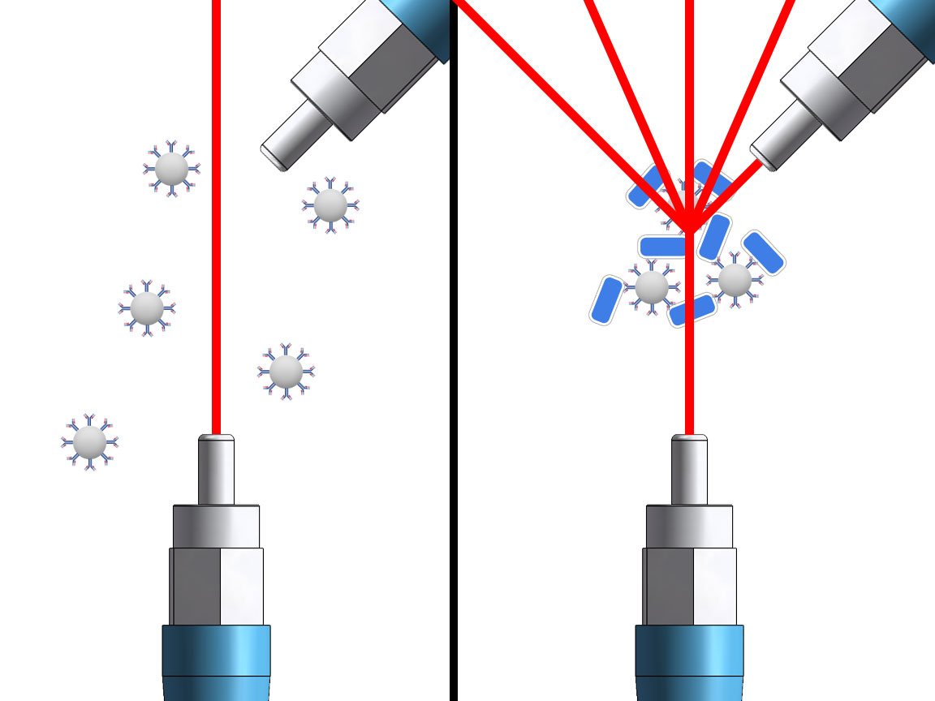
Background
Transducing Element: Light Scattering
A light beam focused through the solution is scattered according to particle size.
Light scattering is directly related to quantity of target in the sample solution.

Slide 6
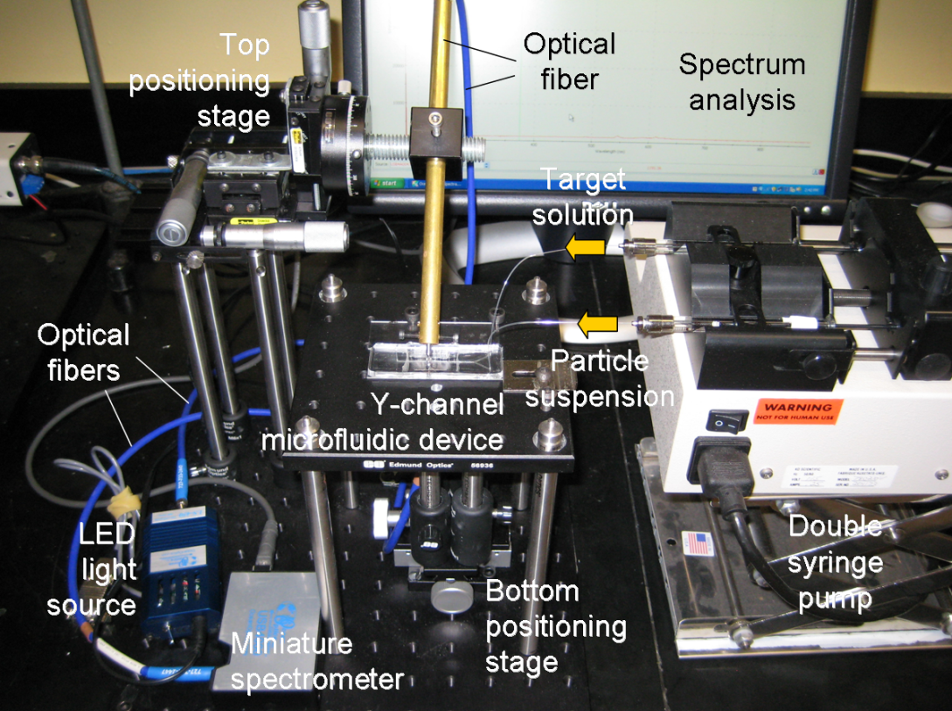
Chip-on-a-lab

Slide 7
Background Summary
Transduction method of light scattering of immunoagglutinated particles provides a rapid and portable solution to pathogen detection required for agriculture
Chip-on-a-lab methodology shows high sensitivity of less than 10 cfu/mL
Preliminary results for differential two-well slide device show high reproducibility and sensitivity to 10³ cfu/mL
  Distinguishable signal at 10² cfu/mL
  Unsteady voltage output due to particles entering and leaving focal region

Slide 8
Using Lettuce Samples
I expanded the previous work to include testing on samples of actual lettuce.
This was done by grinding up iceberg lettuce samples with a mortar and pestle then adding this lettuce to PBS. 2mL PBS for each gram of lettuce (wet weight).

Slide 9
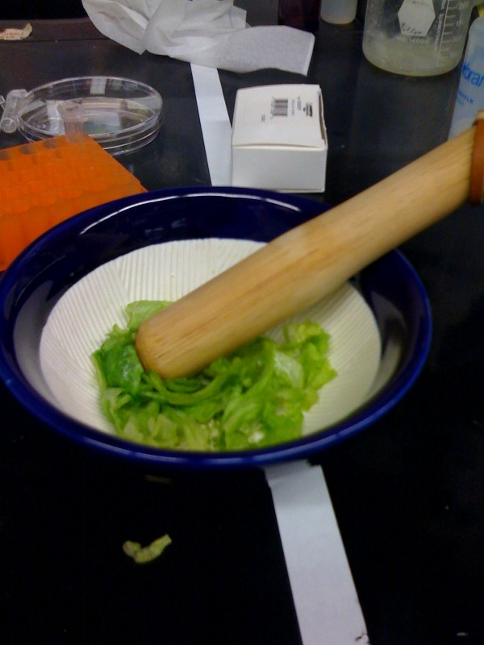

Slide 10
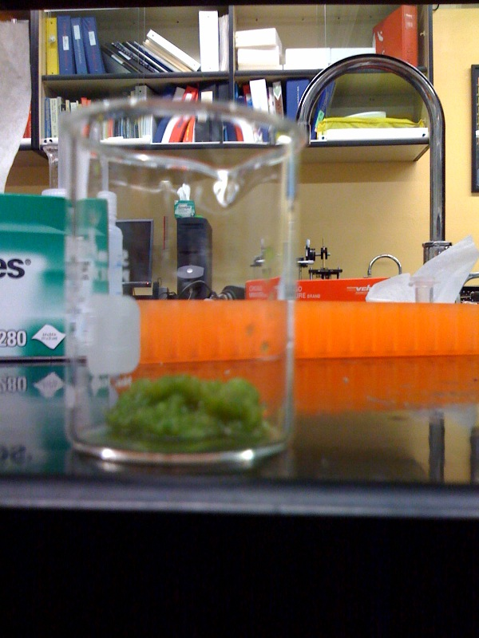

Slide 11
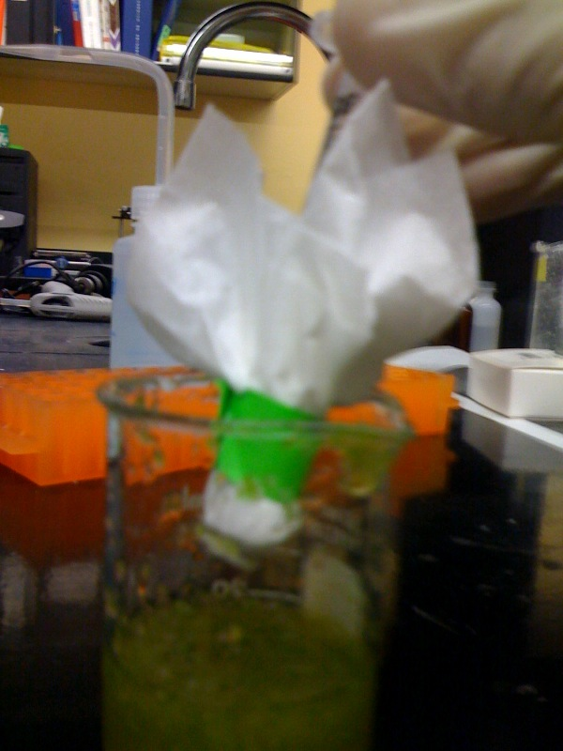

Slide 12
Effect of Time on the Agglutination of the Particles/ Reading
Normalized Intensity Readings
Blank 10⁻⁷ 10⁻⁶ 10⁻⁵ 10⁻⁴ 10⁻³ 10⁻⁷ 10⁻¹ 1
Concentration of E.Coli

Slide 13
I
__
I₀
Blank 100 1000 10⁴ 10⁵ 10⁶ 10⁷ 10⁸ 10⁹
^{CFU}

Slide 14
Chip-on-a-lab Data for 50% standard concentration with 920nm beads
Normalized Intensity Readings
Blank 100 1000 10⁴ 10⁵ 10⁶ 10⁷ 10⁸ 10⁹ 10¹⁰
^{CFU}

Slide 15
Future Work
Reconstructing the Prototype device
Test other vegetables
microfluidic device.
Optimize particle size and concentration

Slide 16
Acknowledgements
Special thanks to:
  David You
  Jeong-Yeol Yoon
  Brian Heinze
  Phat Tran
  Jin-hee Han (UC Davism)
  Lonnie Lucas (Arete, Inc.)
  Austin Folley (Ohio State Med)
  Emma Setterington (U of Michigan)
This work was supported by:
  NVQRS
  Desert Tech

